Slide 1
Mars Express Power Challenge
CC71Q - Introducción a la Minería de Datos
Gabriel De La Parra
25.Abril.2016

Slide 2
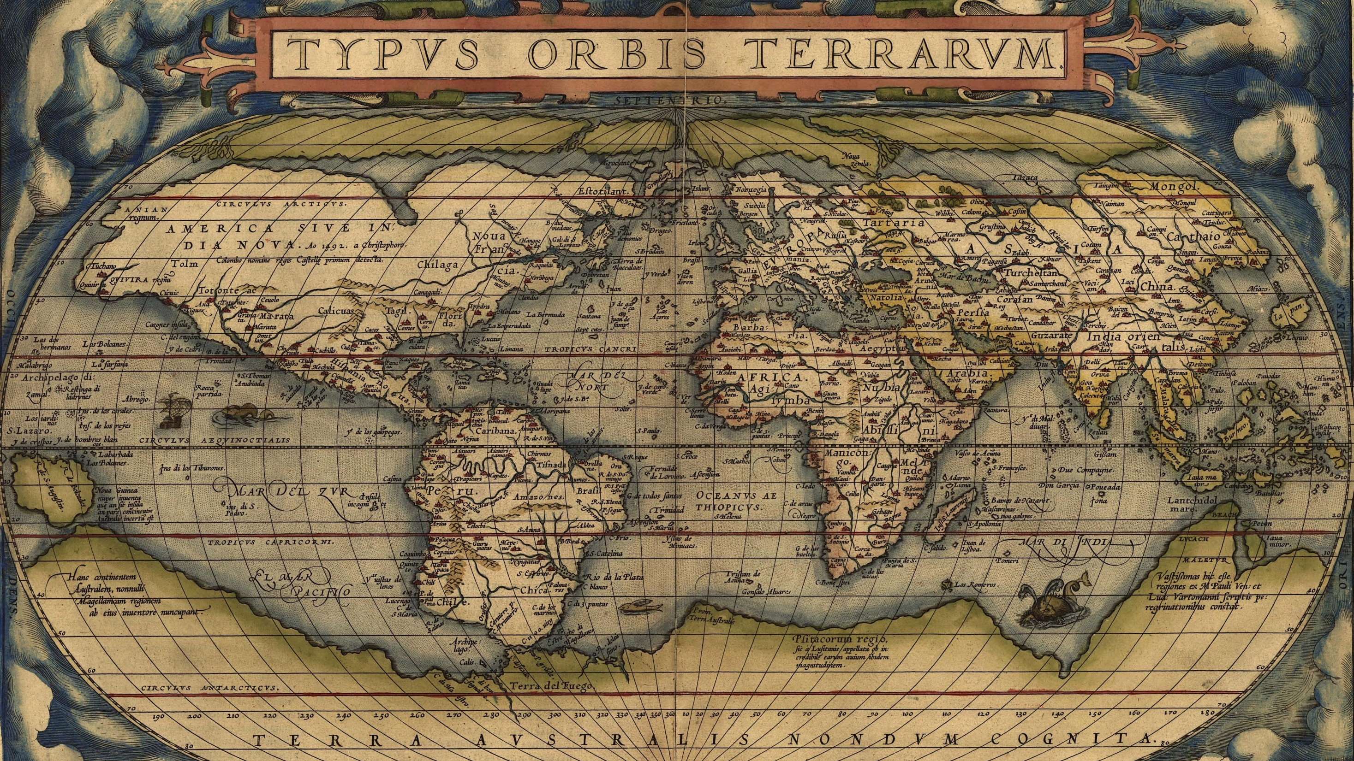
Notes:
Los primeros mapas de la tierra son claramente diferentes a los mapas que tenemos hoy en día.

Slide 3
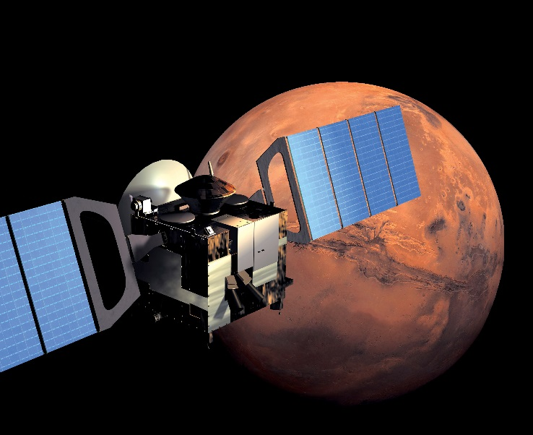
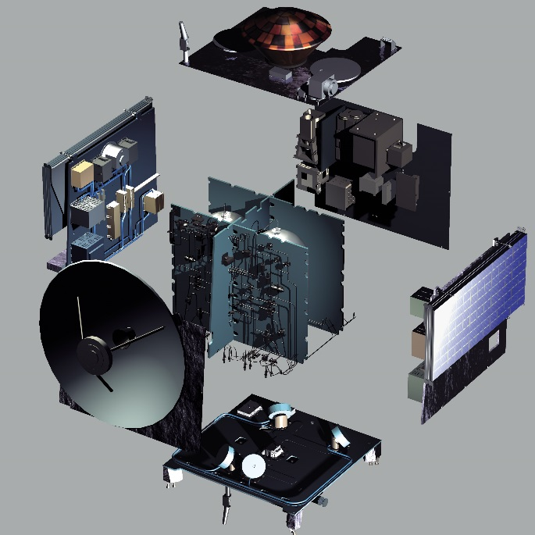
Mars Express Orbiter: Cartografía planetaria
Mission:
Image the entire surface at high resolution (10 metres/pixel) and selected areas at super resolution (2 metres/pixel);
Produce a map of the mineral composition of the surface at 100 metre resolution;
Map the composition of the atmosphere and determine its global circulation;
Determine the structure of the sub-surface to a depth of a few kilometres;
Determine the effect of the atmosphere on the surface;
Determine the interaction of the atmosphere with the solar wind.
Tools:
High Resolution Stereo Camera (HRSC);
Energetic Neutral Atoms Analyser (ASPERA);
Sub-Surface Sounding Radar Altimeter (MARSIS);
Mars Radio Science Experiment (MaRS);
Ultraviolet and Infrared Atmospheric Spectrometer (SPICAM);
Planetary Fourier Spectrometer (PFS);
Visible and Infra Red Mineralogical Mapping Spectrometer (OMEGA);

Slide 4
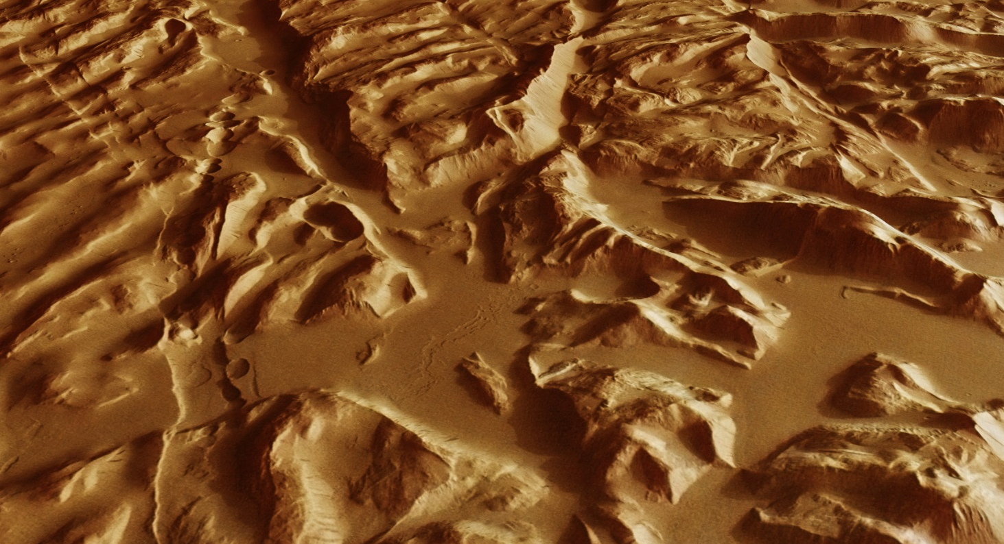
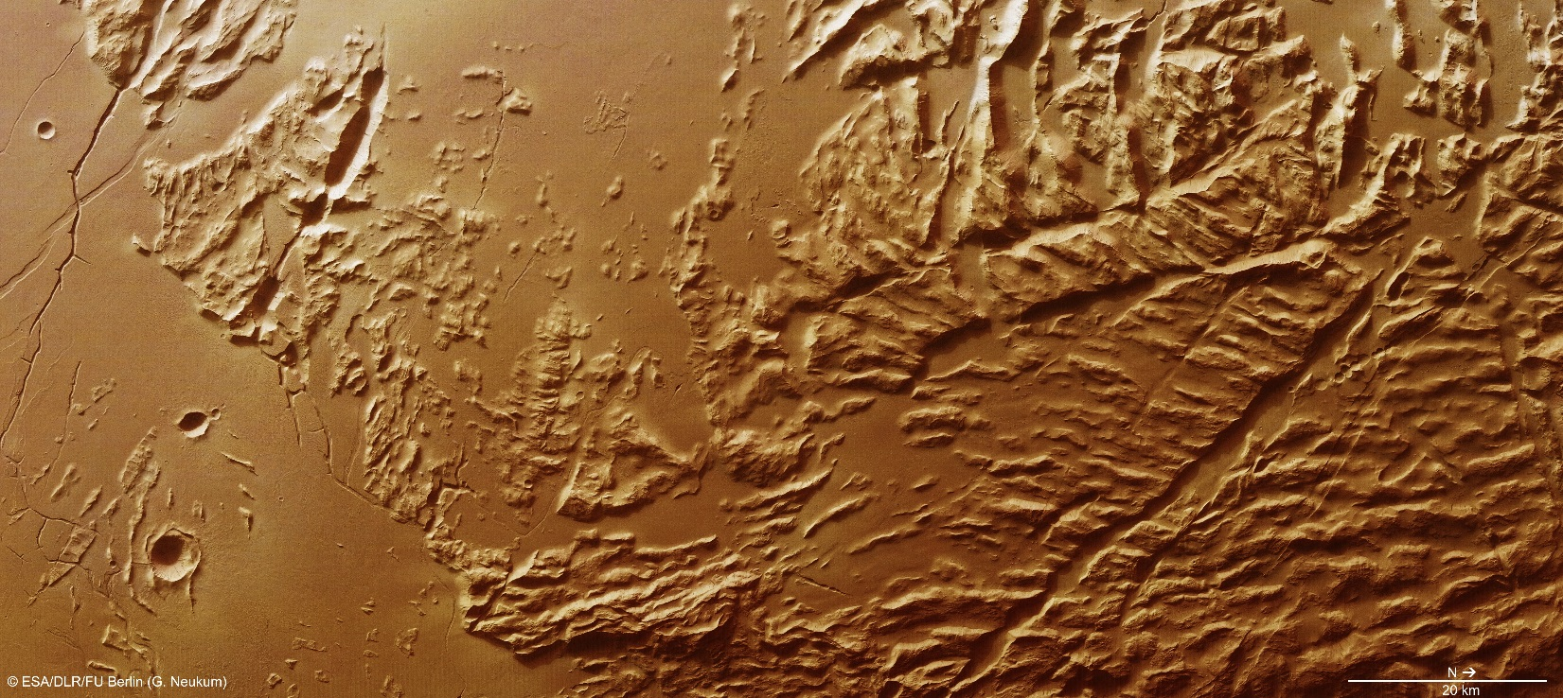
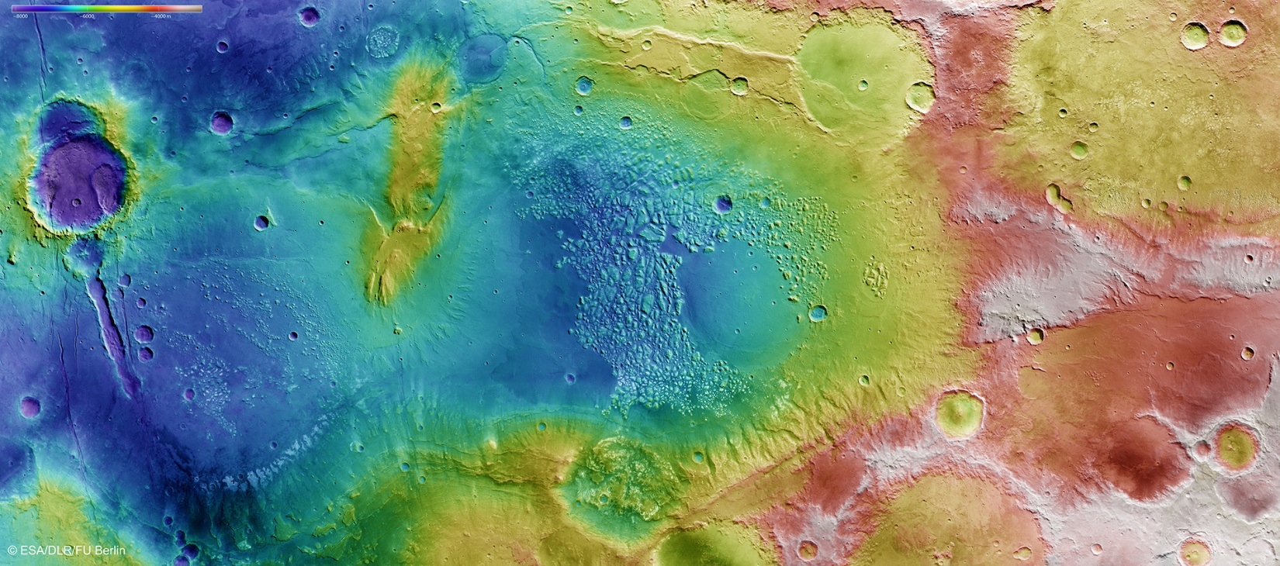
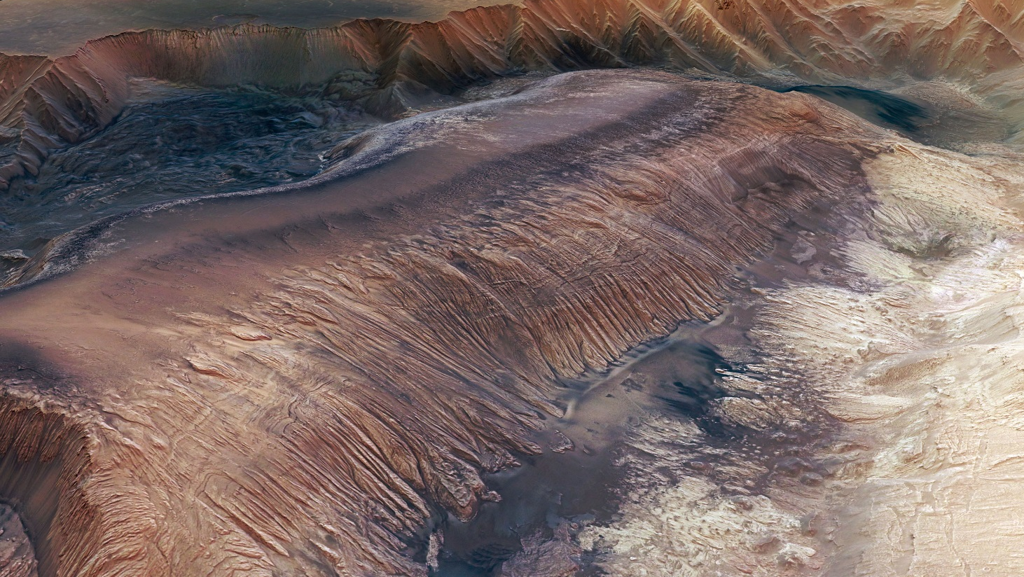

Slide 5
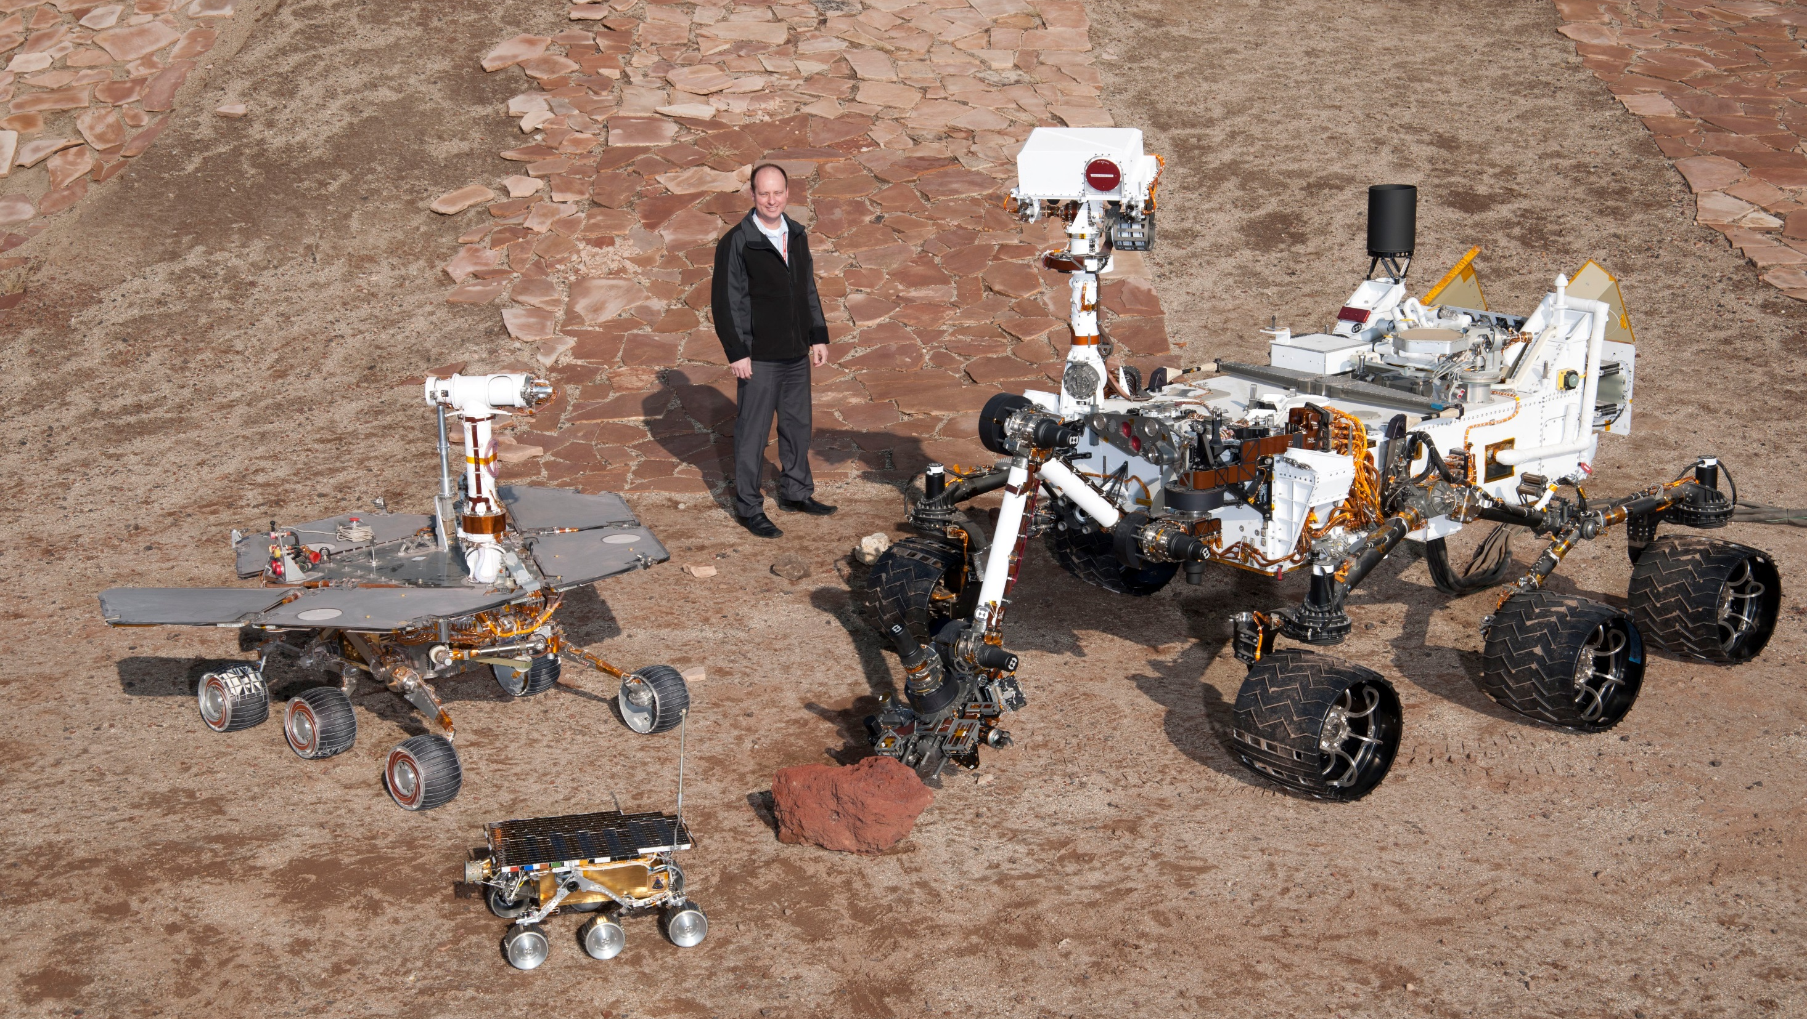
Notes:
Pathfinder, Opportunity, Curiosity

Slide 6
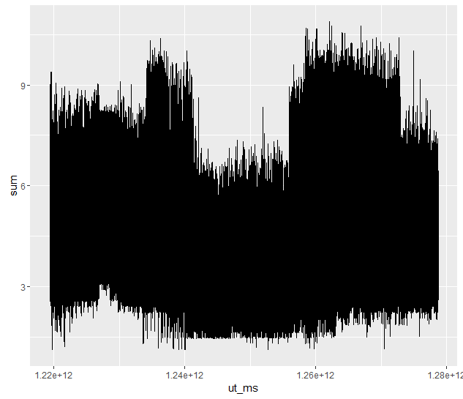
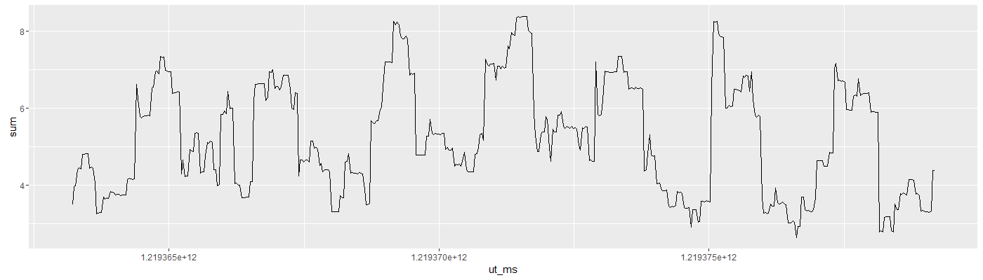
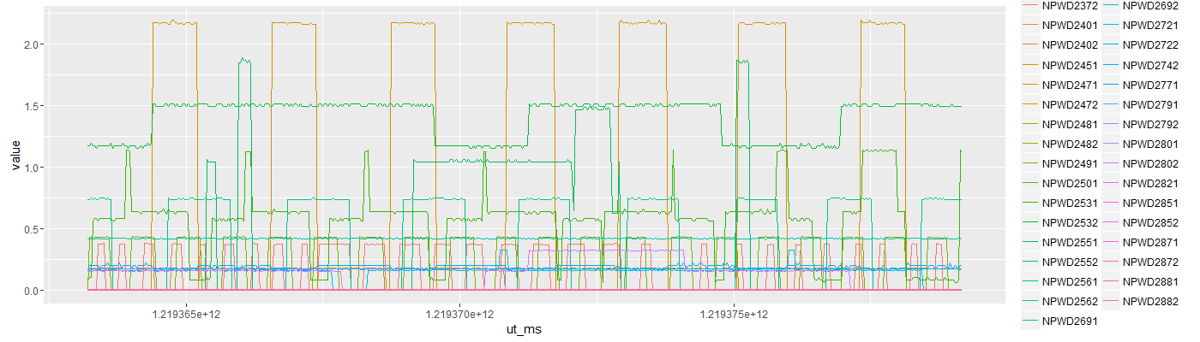
Mars Express Power Challenge Problema: Predicción del consumo energético del satélite
Consumo: 1 año, Suma circuitos
Consumo [1:500]

Slide 7
Mars Express Power Challenge Datos: Estado, Eventos
ut_ms | subsystem
1,219,363,211,000 | AXXX301A
1,219,364,909,000 | AAAAF20C1
1,219,364,914,000 | AAAAF57A1
1,219,364,919,000 | AAAAF23G1
1,219,364,924,000 | AAAAF60A1
1,219,365,615,000 | AXXX305A
1,219,366,035,000 | AXXX380A
1,219,366,635,000 | ASEQ4200
1,219,367,381,000 | ATTTF301E
1,219,369,061,000 | ATTTF310A
1,219,369,181,000 | APSF01A2
1,219,369,301,000 | APSF02A1
1,219,369,306,000 | APSF89A1
1,219,369,311,000 | APSF40A1
1,219,369,316,000 | APSF31A1
1,219,369,481,000 | APSF23B1
1,219,369,486,000 | APSF33A1
1,219,369,491,000 | APSF28A1
1,219,369,496,000 | APSF28A1
1,219,369,501,000 | APSF28A1
ut_ms | description
1,219,364,253,000 | MLG_LOS_05_/_RTLT_02373
1,219,364,356,000 | NNO_AOS_00_/_RTLT_02373
1,219,365,058,000 | MLG_LOS_02_/_RTLT_02373
1,219,365,755,000 | NNO_AOS_05_/_RTLT_02373
1,219,367,159,000 | NNO_AOS_10_/_RTLT_02374
1,219,368,640,000 | 4000_KM_DESCEND
1,219,369,280,000 | MRB_/_RANGE_06000KM_START
1,219,369,855,000 | OCC_MARS_200KM_START_/_RA_181.68_/_DE_-00.08_/_OMP_(296.35,-46.48)_/_SZA_077
1,219,369,949,000 | OCC_MARS_START_/_RA_181.69_/_DE_-00.08_/_OMP_(299.32,-43.44)_/_SZA_076
1,219,369,956,000 | 2000_KM_DESCEND
1,219,370,016,000 | MRB_AOS_00
1,219,370,500,000 | 1200_KM_DESCEND
1,219,370,632,000 | MRB_AOS_10
1,219,370,819,000 | 800_KM_DESCEND
1,219,370,902,000 | MAR_PENUMBRA_START
1,219,370,986,000 | MAR_UMBRA_START
1,219,371,075,000 | MAR_UMBRA_END
1,219,371,094,000 | MRB_LOS_10
1,219,371,152,000 | MAR_PENUMBRA_END
1,219,371,317,000 | MRB_LOS_00
Data Mission Operations
Other Events

Slide 8
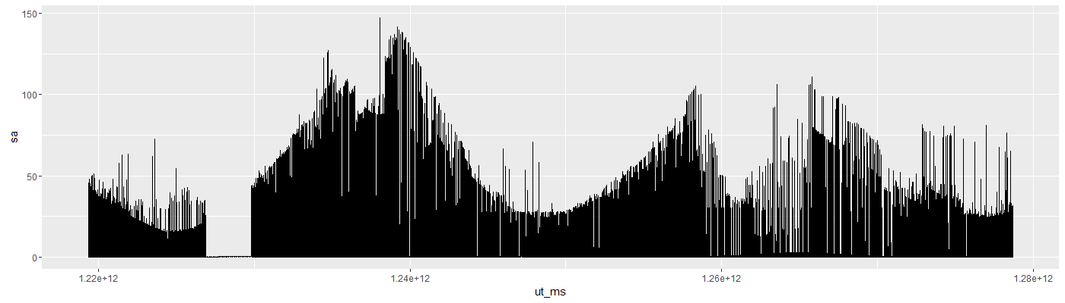
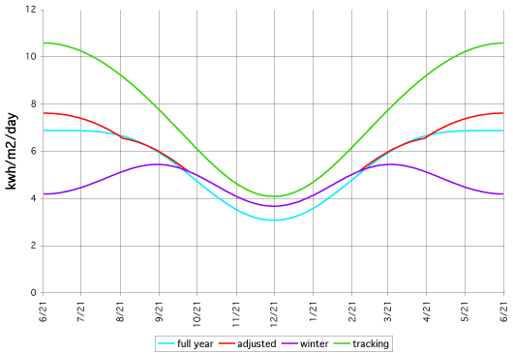
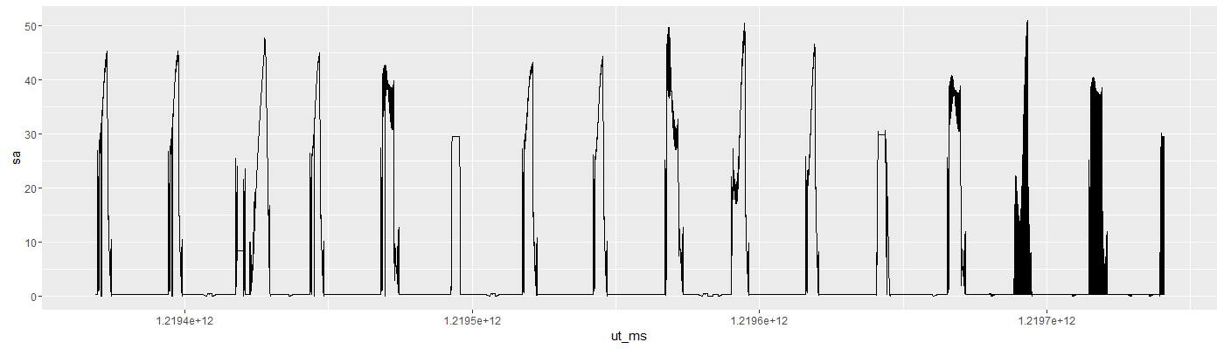
Mars Express Power Challenge Datos: Sol

Slide 9
Mars Express Power Challenge Metodología propuesta
Metodología:
Continuous values prediction: Regression
Pre-procesamiento de los datos:
Identificar y transformar comandos ON/OFF de pulsos a zonas
Eliminar ruido de mediciones
Alinear comandos con tiempos más cercanos
Agregar características: Crecimiento, Varianza
Asociación:
Buscar correlaciones entre circuitos y comandos
Procesamiento:
Entrenamiento por circuitos

